Slide 1
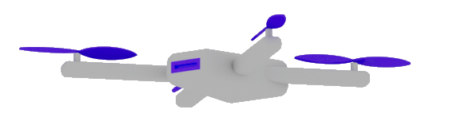
Microsoft Build

Slide 2
Semantic Kernel
Dr. Damir Dobric

Slide 3
GENERATIVE AI

Slide 4
What is a Model?
A model refers to a specific instance or version of an LLM AI

Slide 5
Available GPT Models
Ada
basic natural language understanding
classification, sentiment analysis, summarization, and simple conversation.
Babbage
more complex natural language tasks, such as reasoning, logic, arithmetic, and word analogy.
Curie
advanced natural language tasks, such as text-to-speech, speech-to-text, translation, paraphrasing, and question answering.
Davinci
Handles almost any natural language task,
as well as some multimodal tasks, such as image captioning, style transfer, and visual reasoning.
It can also generate coherent and creative texts on any topic, with a high level of fluency, consistency, and diversity.

Slide 6
AI Services
Open AI
https://platform.openai.com/docs/models
Azure Open AI https://oai.azure.com/portal/****/models

Slide 7
DEMO
Open AI Playground
Azure Open AI Playground

Slide 8
Generative Model Types
Embeddings Models
Completion Models
Chat Models
Semantic Search Applications
The application is based on Completion (prompts)
Chat-GPT Application

Slide 9
Completion Models
Summarize following scientific abstract, using a user-friendly language.
[Abstract] Sparse representation has attracted much attention from researchers in fields of signal processing, image processing, computer vision, and pattern recognition. Sparse representation also has a
good reputation in both theoretical research . . .

Slide 10
Chat Models
Bot: How can I help you?
User: What's the weather like today?
Bot: Where are you located?
User: I'm in Frankfurt.
Bot: It’s 22 degrees and sunny in Frankfurt today.
User: Thanks! Can you explain scientific abstracts?
Bot: Yes. Please provide abstract.

Slide 11
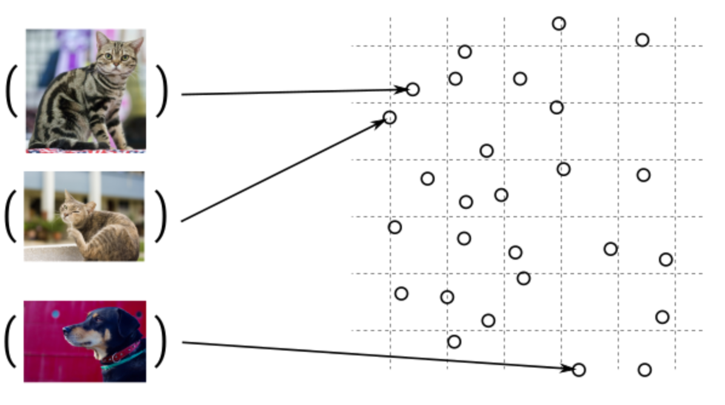
Guess, today is a nice day in Palma
Embedding Models
Today is a typical German rainy day
Two things are infinite: the universe and human stupidity; and I'm not sure about the universe.

Slide 12
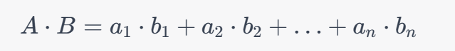
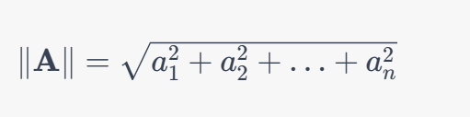
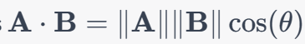
Similarity Between Multidimensional Vectors
Dot Product
The Norm
Cosine Similarity

Slide 13
DEMO
Generating Embeddings with Postman

Slide 14
When to use Embeddings?
Semantic Search
Classification
Grounding

Slide 15
What is a token?
1 token ~= 4 chars in English
1 token ~= ¾ words
100 tokens ~= 75 words
Byte Pare Encoding (Gage,1994): Wikipedia
Tokenizer: https://platform.openai.com/tokenizer
What are tokens and how to count them?
Token Pricing: Pricing (openai.com)

Slide 16
SEMANTIC KERNEL

Slide 17

Software V2
Eine neue Generation von Software
“After tomorrow”
“Tomorrow”
Quantum Computing
Software
Today
AI & Large Language Model Integration
Syntax Driven Languages

Slide 18
Semantic Kernel is an open-source SDK that lets you easily combine Generative AI Models syntactic programming languages like C# and Python.
Currently supported languages: C#, Python
Currently supported AI Services: OpenAI, Azure OpenAI, and Hugging Face
Introduction | 🦜️🔗 Langchain

Slide 19
Deep Dive into Semantic Kernel
Overview of the kernel
Creating native functions
Creating semantic functions
Understanding AI plugins
Chaining functions together
Planer
Create and run a ChatGPT plugin

Slide 20
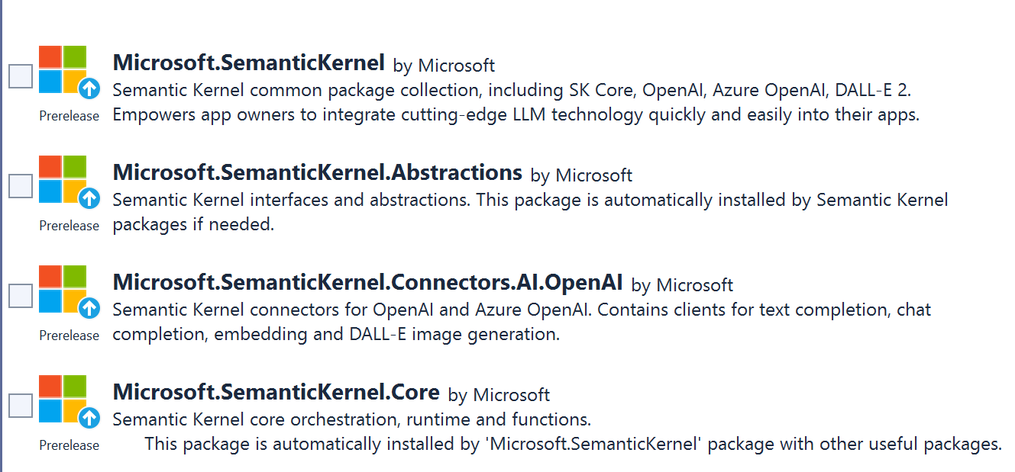
SEMANTIC KERNEL OVERVIEW

Slide 21
Semantic Kernel Initialization with Azure OpenAI
private static IKernel GetAzureKernel()
{
var kernel = new KernelBuilder()
.WithAzureAzureChatCompletionService(„chat-gpt4“,
.WithAzureTextCompletionService(„your deployed model name“,
„The endpoint of your Azure OpenAI service“,
„The API key of your Azure OpenAI service“
)
.Build();
return kernel;
}

Slide 22
Semantic Kernel Initialization with OpenAI
private static IKernel GetAzureKernel()
{
var kernel = new KernelBuilder() .WithOpenAIChatCompletionService(„chat-gpt4-turbo“,
.WithOpenAITextCompletionService("text-davinci-003“,
„Your Organization ID“,
„The API key of your OpenAI service“,
)
.Build();
return kernel;
}

Slide 23
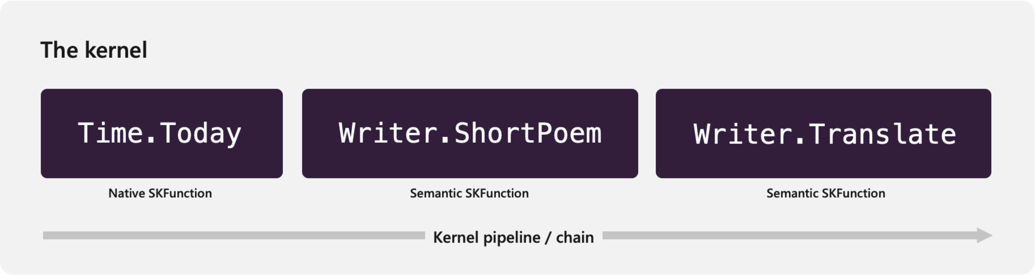
The chain of functions
Get the current time.
Generate a poem about the time, before finally.
Translate it.

Slide 24
Two types of functions
Native Functions
Semantic Functions

Slide 25
NATIVE FUNCTIONS
[SKFunction, Description("Gets the UTC current time.")]
public string UtcNow()
{
return DateTime.UtcNow.ToString();
}
A native function is a function
defined by the code

Slide 26
SEMANTIC FUNCTIONS
Inline Functions
string prompt = @"Bot: How can I help you?
User: {{$input}}
---------------------------------------------
The intent of the user in 5 words or less: ";
A semantic function is a function
defined by the LLM prompt
Plugins
│
│─── Plugin1
│
│─── Function11
│─── Function12
└─── Plugin2
│
│─── Function21
│─── Function22
Add Ins
In-file Functions

Slide 27
Preserving context in Conversation History
Bot: How can I help you?
User: What's the weather like today?
Bot: Where are you located?
User: I'm in Frankfurt.
Bot: It’s 22 degrees and sunny in Frankfurt today.
User: Thanks! Can you explain scientific abstracts?
Bot: Yes. Please provide abstract.

Slide 28
Variables and Context Flow
Context
{{$input}}
{{$var1}}
{{$var2}}
. . .
{{$varN}}
Func1
Func2
prompt

Slide 29
Variables and Context Flow
{{$input}}
{{$var1}}
{{$var2}}
. . .
{{$varN}}
prompt
Func1
Func2

Slide 30
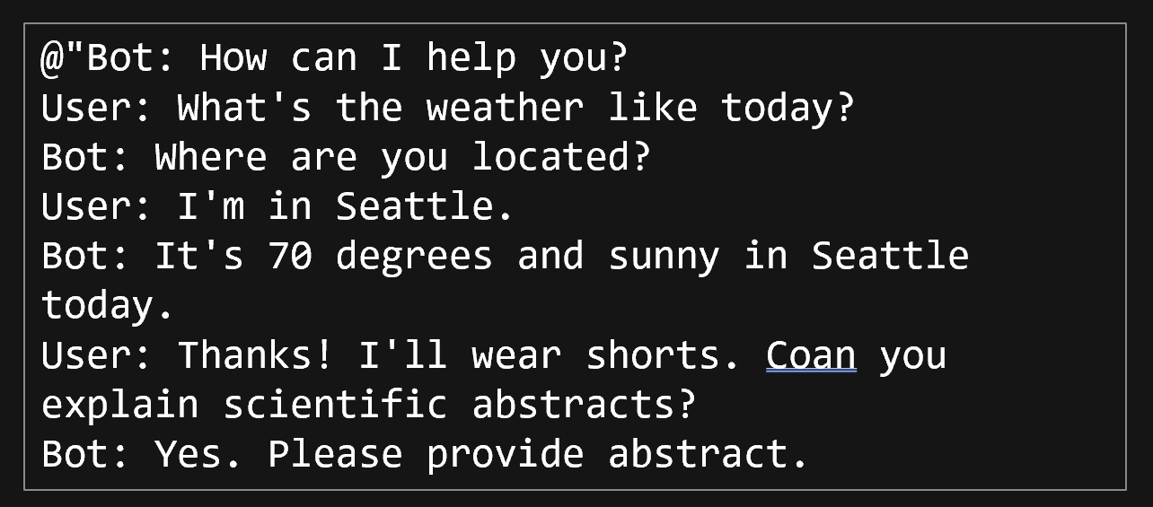
Using Conversation History as variable
[History]
{{$history}}
---------------------------------------------
Summarize scientific abstract, using a user-friendly language.
[Input]
{{$input}}

Slide 31
Using variables (Templatizing), Prompt Template Syntax)
[History]
{{$history}}
User: I'm {{$age}} years old kid.
Bot:Ok, explaining to {{$age}} old kid.
---------------------------------------------
Summarize abstract, using a user friendly language. Use language of the {{$age}} years old kid. Don't use subjects like "we" "our" "us" "your".
If {{$age}} is not on of following options {{$options}} then return an error message similar to 'Sorry, please use some meaningfull age'.
[Input]
{{$input}}
https://learn.microsoft.com/en-us/semantic-kernel/prompt-engineering/prompt-template-syntax

Slide 32
Nested Functions Semantic function invokes semantic function
{{SamplePlugin.Translator $input}}
-----------------------------------------------
Summarize and compress abstract to 50 words, using a user friendly language.
[Input]
{{$input}}

Slide 33
Nested Functions Semantic function invokes native function
{{SamplePlugin.Translator $input}}
--------------------------------------
Summarize the scientific abstract using a user friendly language. Counter = {{StringPlugin.CharCount $input}}
Provide the result in following format:
[Output]
Counter: number,
Text: translated text
[Input]
{{$input}}
--------------------------------------
[Output]
Notes:
Lines ----- are important. Without them translation will be done, but not used as a final result. Final result will be summarized abstract without translation.
Interestingly both lines are required.
2. CharCount will be executed with summarized English text instead of translated text. The function is invoked bevore the translator function is invoked.

Slide 34
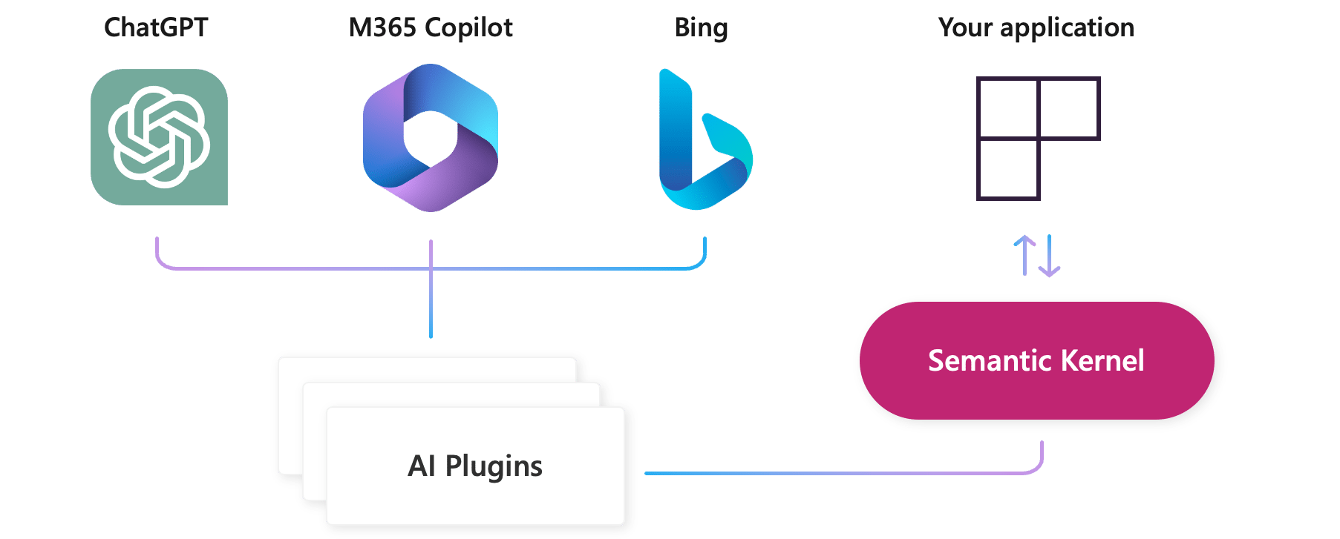
AI Plugins
Your SK application
a plugin is a group of functions
that can be exposed to AI applications
OpenAI plugin specification

Slide 35
Skill

Slide 36
AutoGen Agents Meet Semantic Kernel | Semantic Kernel (microsoft.com)

Slide 37
Microsoft confidential

